Slide 1
Computational Guided Inquiry: Assessing Regional Sea Level Rise Impacts
This module was created by Lea Fortmann, Department of Economics at the University of Puget Sound. Contact the author at lfortmann@pugetsound.edu. Funding for this project comes from NSF award #1712282 by the Division of Undergraduate Education and Office of Polar Programs

Slide 2
Module Overview and Learning Objectives
In this module you will learn some decision-making tools that incorporate risk and uncertainty for estimating the damage costs of sea level rise and flooding in your region. To conduct this analysis you will gather data on home property values and flood probabilities and apply them to a decision-making framework using economic modeling. By the end of the module you will formulate a policy recommendation for how best to adapt to climate change and sea level rise in your region.
Module Outline:
Introduction
Part 1: Calculating Marginal Damages from Flooding and Sea Level Rise
Part 2: Graphing Marginal Damage Curves in Excel
Part 3: Making Decisions Given Uncertainty
Discussion Questions
Learning Objectives:
Increase climate literacy by connecting sea level rise due to ice melt in the polar regions to the local impacts of higher flood levels.
Learn tools to apply to decision-making given uncertainty in sea level rise and flooding.
Gain computational skills through calculating and graphing marginal damage curves in Microsoft Excel.

Slide 3
Introduction – Climate Connection
One of the biggest expected impacts of climate change will be the rise in sea levels as temperatures increase and ice in the polar regions continues to melt at an accelerated pace. Current studies estimate that the total increase in sea level by 2100 will range from 0.2 to 2 meters (NOAA 2016), but there is also the possibility of an increase of 3 meters or more depending on how the pace of polar ice melt.
Sea level rise (SLR) will have significant consequences for coastal cities around the U.S. where an increase of 0.9 meters would displace 2 million or more Americans (Hauer et al. 2016). Higher seas also result in higher flood levels and storm surges, which will potentially cost billions of dollars in damages.
Hurricane Sandy, which hit the Eastern Coast of the U.S. in 2012 and flooded New York’s subway system, is reported to have cost $50 billion in damages (Murphy 2015). Hurricane Harvey hit Houston, TX in 2017 and is estimated to have cost $125 Billion in damages (NOAA 2018) .
Photo Description: Members of the South Carolina's Helicopter Aquatic Rescue Team (SC-HART) perform rescue operations in Port Arthur, Texas, August 31, 2017.
Source: SC National Guard https://www.flickr.com/photos/scguard/36564448210/
Notes:
NOAA 2018 Report: Assessing the U.S. Climate in 2017. Retrieved from website: https://www.ncei.noaa.gov/news/national-climate-201712

Slide 4
Introduction – Polar Connection
While changes in sea levels are expected to be relatively gradual, taking place over hundreds of years, there is much uncertainty in the timing and extent of future sea level rise. Ultimately, it will depend on how fast ice melts in the polar regions, including the Arctic in the north and Antarctic in the south. Cities need to start preparing for these coming changes now. However, trying to determine the best course of action from a policy and urban planning perspective is challenging.
1. To get a better idea about how polar regions can affect global sea level rise, first watch this short video on ice melt in the Antarctic by National Geographic.
2. Next, read this article from the Scientific American: How is World Sea Level Rise Driven by Melting Arctic Ice?
Pause for Analysis: After reading the article, take a moment to think about the following questions:
1. What are the two main drivers of sea level rise discussed in the article?
2. How does sea ice melt contribute to sea level rise?
The Larsen Ice Shelf is situated along the northeastern coast of the Antarctic Peninsula, one of the fastest-warming places on the planet. Image Credit: NASA Earth Observatory image by Jesse Allen, using Landsat data from the U.S. Geological Survey
Notes:
National Geographic video link: https://video.nationalgeographic.com/video/magazine/0000015c-d022-d1cb-a7fd-d4ffc11f0000
Scientific American article: https://www.scientificamerican.com/article/how-is-worldwide-sea-level-rise-driven-by-melting-arctic-ice/

Slide 5
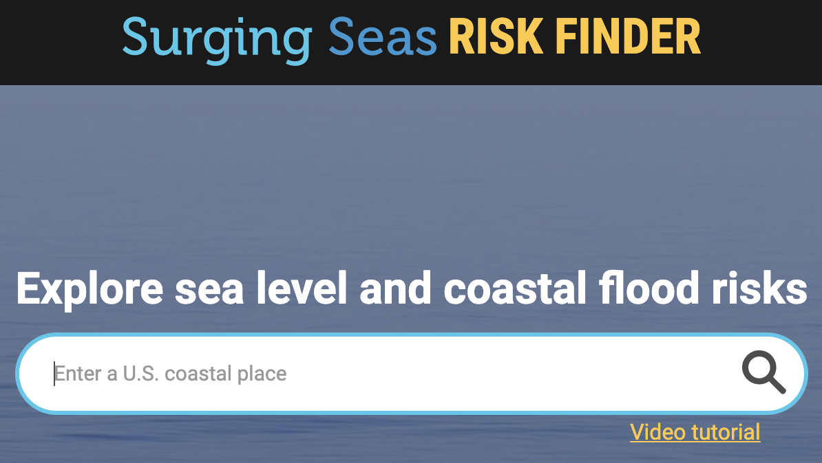
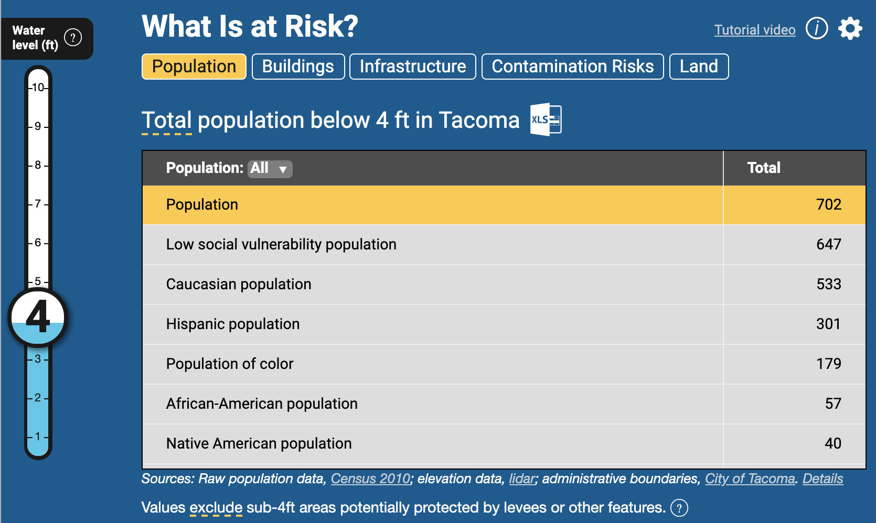
Introduction: Investigating Local SLR Impacts
Now you will take some time to explore how sea level rise will impact your local region through increased storm surges and flooding. Follow the steps below in red and then answer the questions based on information you find on the Risk Finder website.
1. Go to the Surging Seas Risk Finder website that looks at various impacts from flooding in coastal cities in the U.S.
2. Type in your city of interest and take a couple of minutes to explore the website.
3. Based on information from the Risk Finder website, answer the following questions below:
How many different sea level rise scenarios are considered and what are they?
The figure here shows the population at risk in Tacoma, WA at a water level of 4 ft. How many people in the population of your city are at risk given a water level of 6 ft?
How many homes are at risk given 8 ft of flooding? (Hint: click on the “Buildings” tab under “What Is at Risk?”.)
Source: Climate Central Risk Finder https://riskfinder.climatecentral.org/
Notes:
Riskfinder.org website: https://riskfinder.climatecentral.org/place/tacoma.wa.us?comparisonType=city-council-district&forecastType=NRC_High&level=4&unit=ft

Slide 6
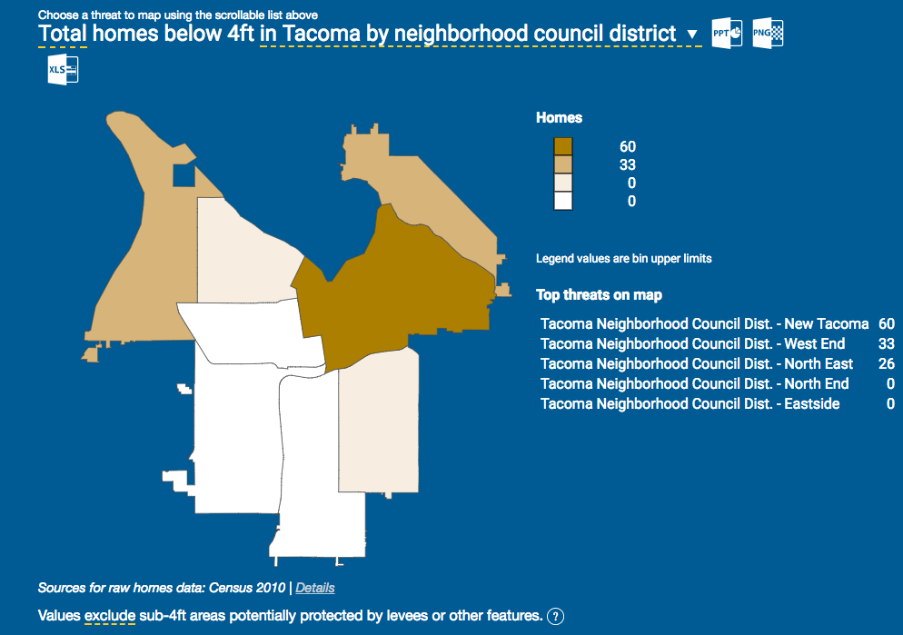
Part I: Estimating Home Values in Flood Prone Areas
With higher sea levels come increased storm surge and flooding. In this section you will estimate local damages associated with higher flood levels by estimating the property damage that would occur at each level of flooding based on regional housing values and the number of homes that are impacted. To start, follow the directions in red below.
To get housing values, go to the ArcGIS website here to find median home values in the U.S. for the year 2012.
Type your location of interest into the search bar at the top left of the screen then use the + button in the upper left corner to zoom into the area.
Click on a block to see the median home price in that block group for 2012.
Now look at the Surging Seas Risk Finder website for your city, (Tacoma, WA shown here) and scroll down to see what areas are most at risk due to flooding. Note: be sure to click on “Buildings” and then “Homes” under the "What is at Risk?” section to see the correct map.
Compare these two maps and decide on a representative median home price to use in the analysis for estimating flood damages.
Source: ESRI ArcGIS
Pause for Analysis: Discuss with a partner or in a small group how you decided on what home price to use for this analysis.
Source: Climate Central Risk Finder https://riskfinder.climatecentral.org/
Notes:
ArcGIS Housing data website: https://www.arcgis.com/home/webmap/viewer.html?useExisting=1&layers=8abd47c2988d497a8f24ad89180980c8

Slide 7
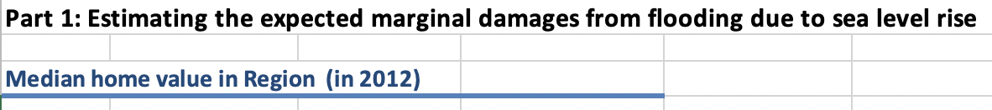
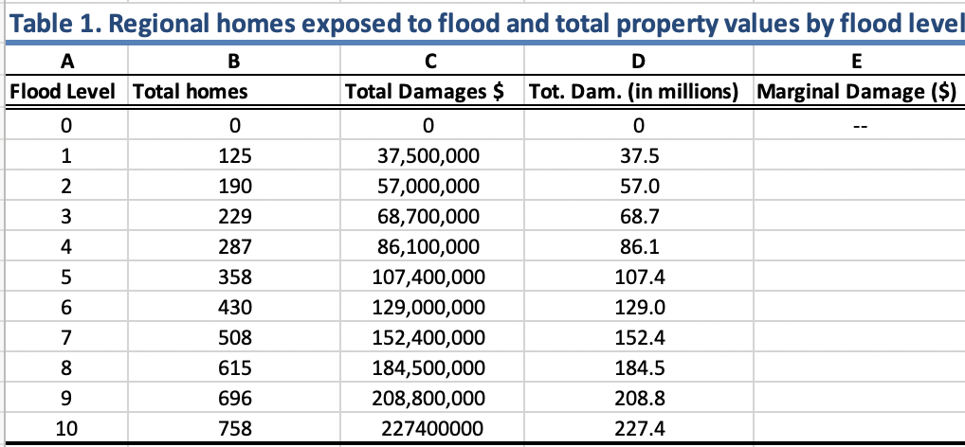
Part I: Calculating the Marginal Damage Cost of Flooding
Now that you have an median housing price, you will use this data to calculate the damages from flooding in your region based on the number of homes that will be impacted at various flood levels.
1. To get started, open the Excel file for “CGI SLR Module”, then click on the tab for “Part 1: MD Tables” at the bottom.
2. Look at Table 1 to see the total number of homes that will be exposed at each level of flooding in your region*.
3. Use the median housing price you decided on from the previous slide and double click on cell D3. Type the value into your Excel spreadsheet and hit ‘enter’.
Notice Columns C and D in Table 1 populate with the total property damages at each flood level, which is calculated by multiplying the number of houses exposed (Column B) by the median home value you just typed in to get the total damage costs.
*Housing data displayed here is sourced from: Climate Central (2014). Sea level rise and coastal flood exposure in Tacoma, WA, in Surging Seas Risk Finder. Retrieved from ssrf.climatecentral.org/#p=L&state=Washington&location=WA_Town_5370000

Slide 8
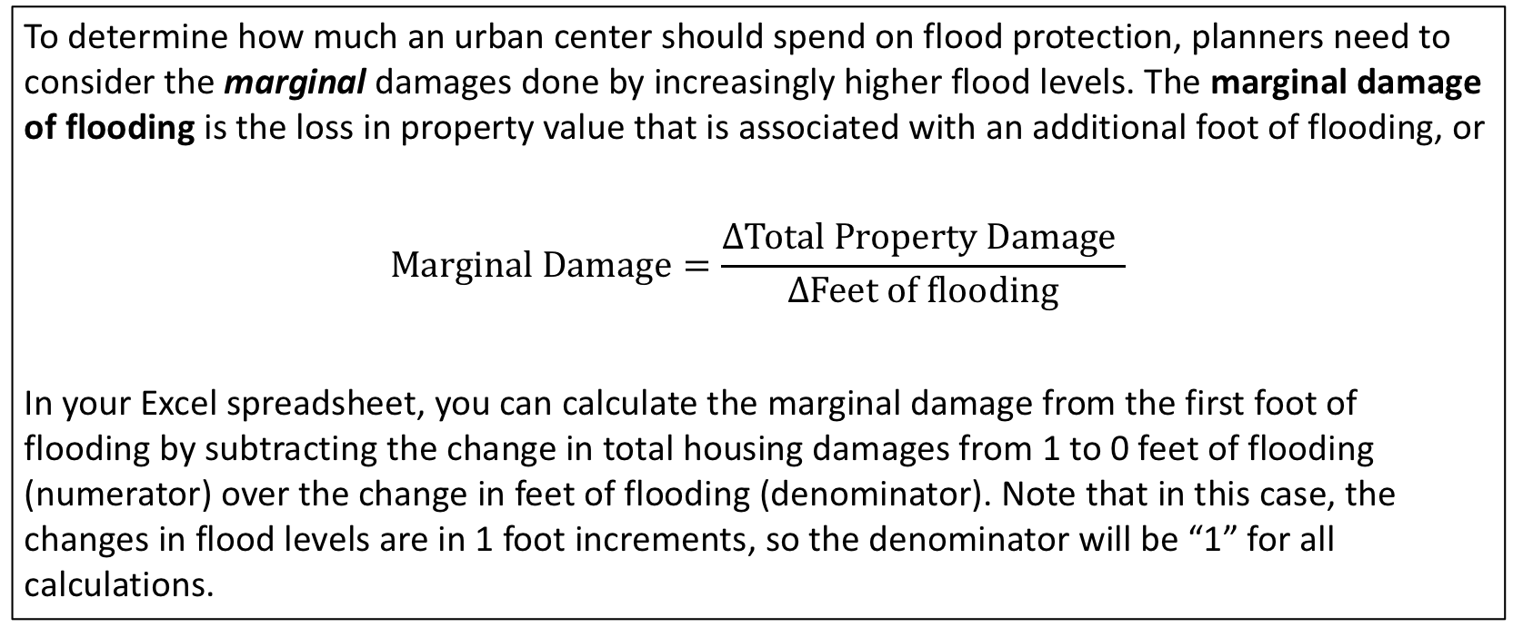
Part I: Calculating Marginal Damage Costs from Flooding
To determine how much an urban center should spend on flood protection, planners need to consider the marginal damages done by increasingly higher flood levels. The marginal damage of flooding is the loss in property value that is associated with an additional foot of flooding, or
$$Marginal Damage=\frac{∆Total Property Damage }{∆Feet of flooding}$$
In your Excel spreadsheet, you can calculate the marginal damage from the first foot of flooding by subtracting the change in total housing damages from 1 to 0 feet of flooding (numerator) over the change in feet of flooding (denominator). Note that in this case, the changes in flood levels are in 1 foot increments, so the denominator will be “1” for all calculations.

Slide 9
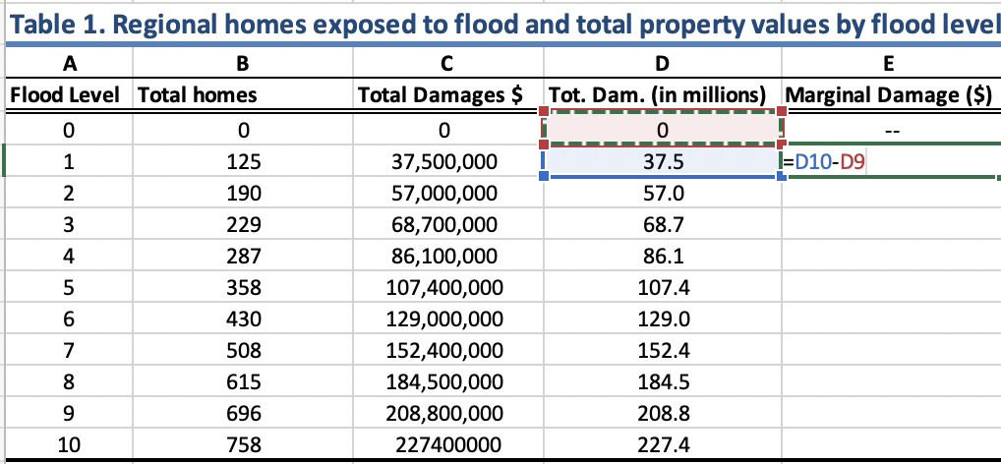
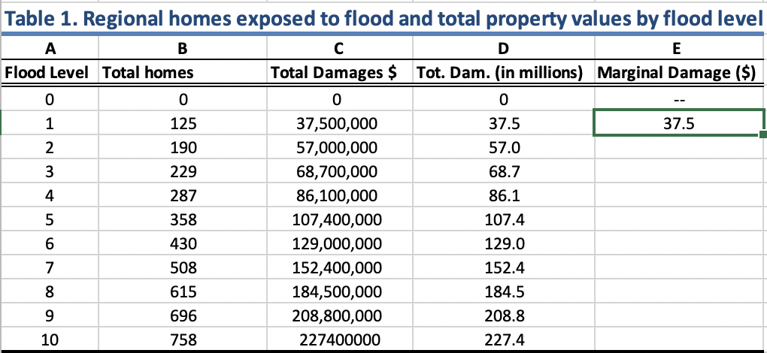
Part I: Calculating Marginal Damage Costs from Flooding
After reviewing the formula for calculating marginal damage costs on the previous slide, you will now apply it to your region by calculating the marginal damages from flooding from 0 to 10 feet in Table 1.
1. To calculate the marginal damages, subtract the total damages given 1 ft of flooding from damages with 0 ft of flooding, by typing the formula “=D10-D9” into cell E10, under Marginal Damages (column E) then hit ‘enter’.
2. Click on the cell to show the green border, then click on the square in the lower right corner and drag it down to the last cell in the column to copy the formula into these cells.
Excel Tip: You can also click on the cell to fill in the cell reference in the formula (e.g. D10) instead of typing it.
Pause for Analysis: In a group or with a partner, discuss what assumptions you are making about how flood damages will impact houses based on the calculations for marginal damages you just made here, i.e. interpret the value in the cell E10. Do you think this is an over or under estimate of flood damages?

Slide 10
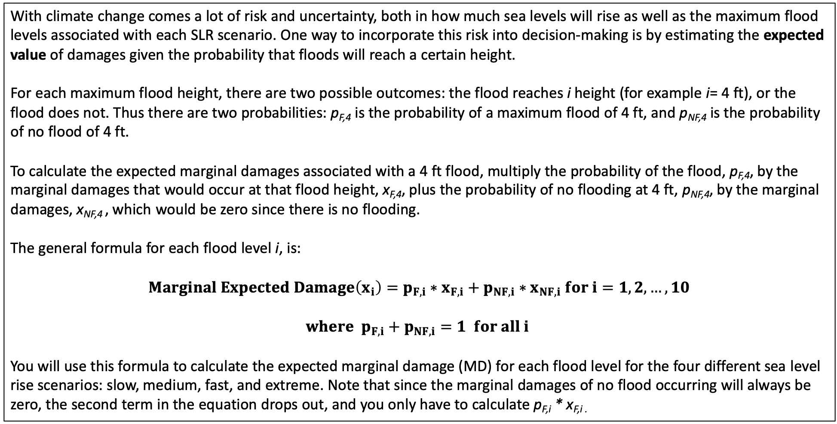
Part 1: Calculating Expected Damages from Flooding
With climate change comes a lot of risk and uncertainty, both in how much sea levels will rise as well as the maximum flood levels associated with each SLR scenario. One way to incorporate this risk into decision-making is by estimating the expected value of damages given the probability that floods will reach a certain height.
For each maximum flood height, there are two possible outcomes: the flood reaches i height (for example i= 4 ft), or the flood does not. Thus there are two probabilities: p_{F,4} is the probability of a maximum flood of 4 ft, and p_{NF,4} is the probability of no flood of 4 ft.
To calculate the expected marginal damages associated with a 4 ft flood, multiply the probability of the flood, p_{F,4}, by the marginal damages that would occur at that flood height, x_{F,4}, plus the probability of no flooding at 4 ft, p_{NF,4}, by the marginal damages, x_{NF,4} , which would be zero since there is no flooding.
The general formula for each flood level i, is:
$$Marginal Expected Damage\left(x_{i}\right)=p_{F,i}∗x_{F,i}+p_{NF,i}∗x_{NF,i} for i=1,2,…,10$$
$$where p_{F,i}+p_{NF,i}=1 for all i$$
You will use this formula to calculate the expected marginal damage (MD) for each flood level for the four different sea level rise scenarios: slow, medium, fast, and extreme. Note that since the marginal damages of no flood occurring will always be zero, the second term in the equation drops out, and you only have to calculate p_{F,i} * x_{F,i .}

Slide 11
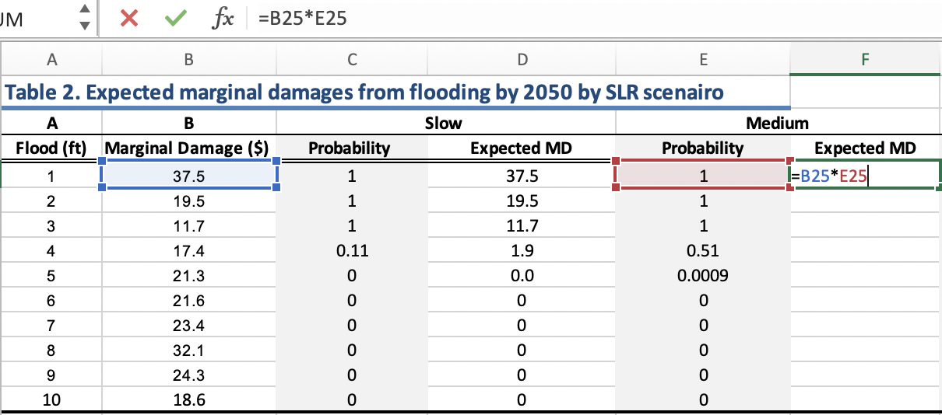
Part 1: Calculating Expected Damages from Flooding
Now you will use the formula from the previous slide to calculate the expected marginal damages for each flood level in Table 2. They have already been calculated for you for the “Slow” sea level rise scenario for the year 2050. You will calculate them for the “Medium” scenario below. (Note that the marginal damages in column B are the same as the ones you calculated above in Table 1.)
1. To calculate the Expected MD for the Medium SLR scenario in Table 2, multiply the marginal damage of flooding (x_{F,1} ) by the probability of flooding (p_{F,1} ) for a max flood height of 1ft using the formula “=B25*E25”.
2. Drag down the formula to replicate it in the rest of the column.
3. Repeat this process for the Fast and Extreme scenarios to complete Table 2.
Pause for Analysis: Discuss with a partner or in a small group how you would interpret the value in cell F29 in Table 2 in your Excel spreadsheet. Be as specific as possible.

Slide 12
Part 1: Calculating Expected Damages from Flooding
Now you will complete Table 3 which shows the expected marginal damages for the year 2100. To do this you will need to get data on the probability of flooding at each water level for the year 2100 from the Surging Seas Risk Finder website.
Note: Make sure the setting is for “Multi-year risk of flooding”
1. On the Risk Finder website for your region select the “Medium” sea level scenario on the right side of the graph and the 4 ft water level on the left side (default).
2. Hover over the year of interest on the bar chart (2050) to see the probability of at least one flood of 4 ft or higher by 2050 (51% or 0.51 for Tacoma, WA).
3. Fill out the “Probability” column in Table 3 for the Medium rise scenario by repeating this process to find the probabilities for each level of flooding for the year 2100.
4. Complete the rest of Table 3 by calculating the expected MD for the Medium, Fast, and Extreme scenarios.
Pause for Analysis: The multi-year likelihood is the probability of at least one flood occurring in the given period (e.g. 2016-2050), though there could be more. Consider the assumptions made in this analysis so far, would more than one flood occurring in the period affect the damage costs? Why or why not?

Slide 13
Part 2: Graphing Marginal Damage Curves
The marginal damage tables are a helpful way to organize the data and do some basic calculations, but when presenting the data, graphs are a better way to convey a lot of information in one figure. In this section you will make graphs of the expected marginal damages you just calculated in Excel.
Click on the “Part 2: MD graphs” tab at the bottom of the Excel spreadsheet. Tables 4 and 5 show the expected marginal damages from flooding for each SLR scenario for the year 2050 (Table 4) and 2100 (Table 5). Note: The tables have automatically populated with the expected MD values you calculated on the previous spreadsheet.
Excel Tip: If you click on a cell, you can see the reference cell it is drawing the data from in the formula bar (fx) at the top, where ‘MD Table’ is the sheet name you were previously working in and E26 is the cell on that sheet the data is copied from into the current cell.
Now you will create a graph with the four SLR scenarios to show the marginal damages expected at each foot of flooding. A graph of Table 4 for the year 2050 has already been made for you, in the next slide you will learn how to create the same graph for Table 5 for the year 2100.

Slide 14
Part 2: Graphing Marginal Damage Curves
To make a graph in Excel:
1. Use the cursor and drag to highlight the contents of the Table as pictured.
2. Go to the Insert tab at the top then click on the drop down options for scatter charts and select the option with smooth lines and markers.
Note: These instructions and images are for a Mac using Excel version 16.25 and may differ for a PC or other versions of Excel, but should be similar.
Excel Tip: You can click on the graph and drag it to move it around your spreadsheet. Note: The x-axis will be based on the far left-hand column units (feet of flooding) and the y-axis will be in millions of dollars. The legend is based on the column headings.

Slide 15
Part 2: Formatting Graphs in Excel
After you make your graph, you will want to add a main title to the graph and labels for the horizontal and vertical axes. If someone was to look at your graph out of context, they should be able to understand exactly what data is being displayed.
Formatting Graphs in Excel
1. To add a title, click anywhere on the graph and a Chart Design tab should appear at the top.
2. Click on on the Chart Design tab and from there you should see a drop down for adding chart elements.
3. Add a Chart Title to your graph and vertical and horizontal Axis Titles.
Pause for Analysis: What do you think are some of the underlying factors driving the shape of the marginal damage curves in the graphs? Hint: Think about the assumptions you have made when calculating the marginal damages. Discuss with a partner or in a small group.

Slide 16
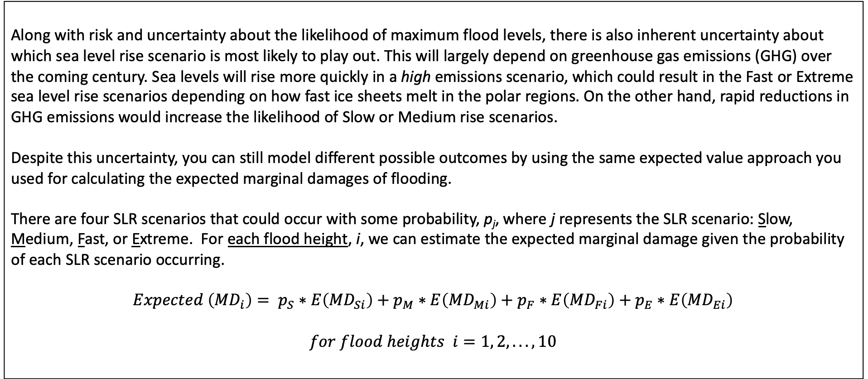
Part 3: Making Decisions Under Uncertainty
Along with risk and uncertainty about the likelihood of maximum flood levels, there is also inherent uncertainty about which sea level rise scenario is most likely to play out. This will largely depend on greenhouse gas emissions (GHG) over the coming century. Sea levels will rise more quickly in a high emissions scenario, which could result in the Fast or Extreme sea level rise scenarios depending on how fast ice sheets melt in the polar regions. On the other hand, rapid reductions in GHG emissions would increase the likelihood of Slow or Medium rise scenarios.
Despite this uncertainty, you can still model different possible outcomes by using the same expected value approach you used for calculating the expected marginal damages of flooding.
There are four SLR scenarios that could occur with some probability, p_{j}, where j represents the SLR scenario: Slow, Medium, Fast, or Extreme. For each flood height, i, we can estimate the expected marginal damage given the probability of each SLR scenario occurring.
$$Expected \left({MD}_{i}\right)= p_{S}∗E\left({MD}_{Si}\right)+p_{M}∗E\left({MD}_{Mi}\right)+p_{F}∗E\left({MD}_{Fi}\right)+p_{E}∗E\left({MD}_{Ei}\right)$$
$$for flood heights i=1, 2,... ,10$$

Slide 17
Part 3: Making Decisions Under Uncertainty
In this analysis you will refer to 3 different emissions scenarios modeled after the Intergovernmental Panel on Climate Change (IPCC) report on Representative Concentration Pathways (RCPs):
RCP 2.6* is the best case scenario which would result in the lowest sea level rise and associated warming of 0.5 to 2.8 °F by the year 2100.
RCP 4.5 is a moderate scenario in which GHG emissions stabilize by 2100, which would result in approximately 2 to 4.6°F of warming by 2100.
RCP 8.5 is the worst case scenario, which would result in the highest sea level rise and potentially the extreme scenario playing out with associated warming of 4.5 to 8.6°F by 2100.
For more information on the RCPs, you can refer to the Summary for Policy Makers by the IPCC (2013).
Pause for Analysis: Consider the best case and worst case scenarios described above. In a small group or with a partner discuss what factors (economic, social, political, technological, etc.) would increase the probability of the best case scenario playing out? What factors would increase the probability of the worst case scenario playing out?
*The number reference for the RCP scenarios refers to the radiative forcing associated with that scenario, or the “cumulative measure of human emissions of GHGs from all sources expressed in Watts per square meter” (Scenario Process for AR5 (2019) Data Distribution Centre. Retrieved from: https://sedac.ciesin.columbia.edu/ddc/ar5_scenario_process/RCPs.html).
Notes:
Summary for Policy Makers Report (IPCC 2013) website: https://www.ipcc.ch/site/assets/uploads/2018/02/WG1AR5_SPM_FINAL.pdf

Slide 18
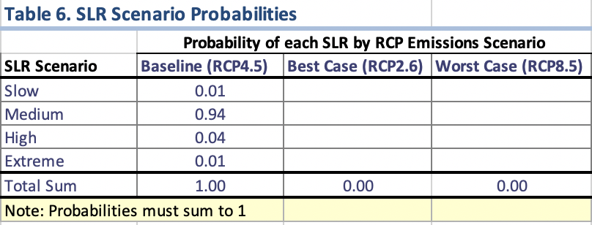
Part 3: Making Decisions Under Uncertainty
Now you will consider probabilities of sea level rise for 3 different GHG emissions scenarios: Baseline, Best Case and Worst Case. In Part 3 of the Excel spreadsheet on the “Cost-Benefit Graph” tab, the first column in Table 6 shows the probabilities of each SLR scenario occurring under a Baseline scenario (RCP4.5). The numbers are roughly based on a 2017 NOAA report. Using these as a starting point, you will consider probabilities for SLR under the Best and Worst Case scenarios.
1. Fill in probabilities for the Best and Worst case scenarios in Table 6 based on what you think the likelihood is of each SLR scenario occurring given your discussion on factors driving the best and worst case emissions scenarios from the previous slide.
Notice that as you fill in the probabilities, Table 7 populates with the expected marginal damages for each foot of flooding for the respective emissions scenarios, along with the graph of the marginal damages associated with each emissions scenarios in Figure 3.
2. To get a sense of how the probabilities affect the marginal damage curves in Figure 3, play around with entering in different probabilities for the Best and Worst Case scenarios in Table 6.
Pause for Analysis: What is a claim you can make about the marginal damages from sea level rise based on the probabilities you have entered and your analysis of the graph in Figure 3?
Notes:
NOAA 2017: Sweet, W. V., Kopp, R. E., Weaver, C. P., Obeysekara, J., Horton, R. M., Thieler, E. R., and Zervas, C. (2017). Global and Regional Sea Level Rise Scenarios for the United States. NOAA Technical Report NOS CO-OPS 083. Retrieved from: https://tidesandcurrents.noaa.gov/publications/techrpt83_Global_and_Regional_SLR_Scenarios_for_the_US_final.pdf

Slide 19
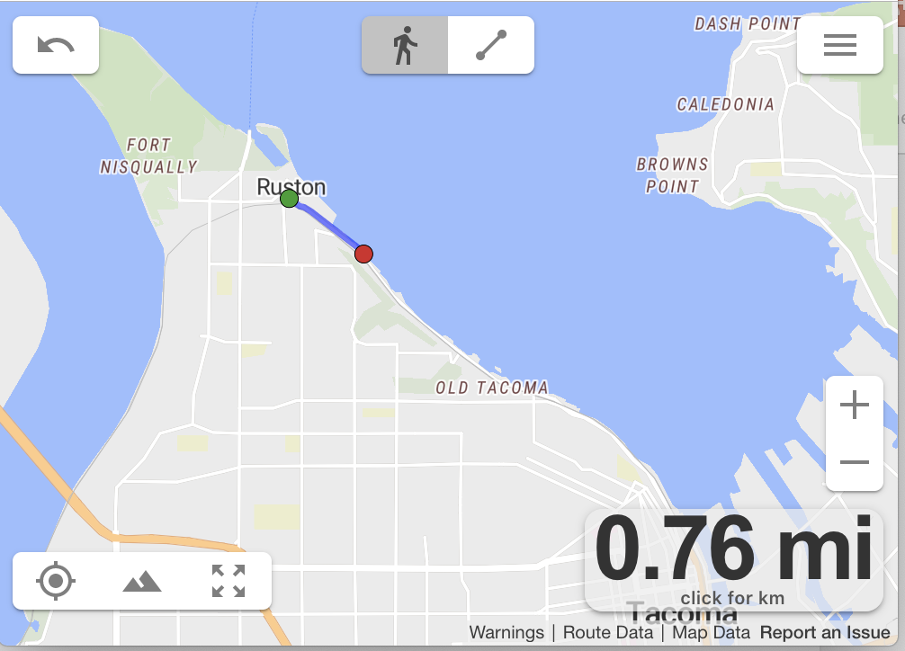
Part 3: Estimating the Cost of Building a Seawall
The final part of the analysis is to consider how much it would cost to prevent these damages. One option to consider is building a sea wall along the shoreline that would prevent the water from reaching the homes given a flooding event.
1. Consider the highest priority shoreline in your region to be protected and estimate the length of the seawall using the website: onthegomap
2. Click on the target in the lower left corner. Then click on the map at the starting point of the wall. To estimate the distance, continue clicking new points along the seawall path using the nearest road or path to the shoreline. To undo a point, click the reverse arrow in the upper left corner.
3. Determine how many feet long the wall would need to be using the conversion, 1 mile = 5280 feet.
In a report on cost estimates of coastal protection, researchers estimated that the cost of building a sea wall is $762 per square foot (Hudson et al. 2015). Assume that the additional cost of building the sea wall 1 foot taller is constant at $762 per square foot for every foot taller the wall is built, i.e. marginal costs are constant.
Pause for Analysis: How much would it cost to build a 1 foot tall sea wall along the length of the shoreline you just measured? After you’ve built the seawall 1 foot tall, how much would it cost to build it another foot taller?
Notes:
Mapping website: https://onthegomap.com/#/create

Slide 20
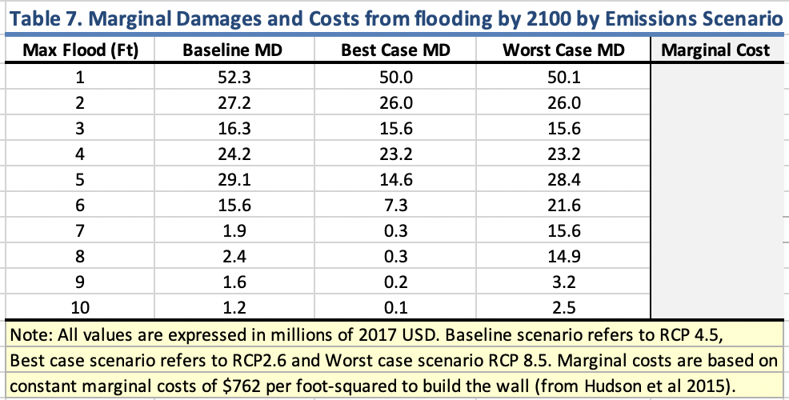
Part 3: Estimating the Cost of Building a Seawall
Now that you have estimates for the cost of building the seawall, the final step is to compare the marginal cost of the sea wall compared to the avoided damages it would prevent to answer two questions:
Is building a sea wall cost effective, that is, would the benefit of building the seawall (measured in avoided housing damages) be greater than the cost?
If it is in the best interest of the region to build a seawall, how tall should it be?
1. To answer these questions, use the cost estimates you calculated on the previous page to fill in the “Marginal Cost” column in Table 7 for the marginal cost of the seawall at each flood height.
2. Notice that the graph in Figure 3 now displays the marginal cost curve for the sea wall.
Pause for Analysis: As a city planner, what recommendations would you make based on your analysis of the graph in Figure 3, i.e. how tall should the wall be? How do the total costs and benefits compare to the marginal costs and benefits of the seawall? Discuss with a partner or in a small group.

Slide 21
Discussion Questions
With a partner or in a small group, discuss the following questions:
Figure 3 highlights all the work you have done thus far in this analysis. With this in mind, what are some of the main assumptions you have made that are underlying the graph, specifically in the calculations for the marginal cost and expected marginal damage curves?
If you were to change these assumptions, how do you think the results would change? How might this change your recommendation on the seawall?
Given the assumptions and limitations you have discussed, how would you go about improving this analysis to make it more realistic?
The extreme sea level rise scenario has a very low probability of occurring. In fact one model reports that even in the event of the worst case scenario (RCP8.5) the likelihood of 2.5+ meters of sea level rise by the end of the century is only 0.1% (Kopp et al. 2014; NOAA, 2017). Given this small probability, why do you think it is still important to take these extreme scenarios into consideration?

Slide 22
Post-Module Memo Assignment
Sea Level Rise Memo Assignment
Suppose that you were hired by the City to conduct an analysis on the impacts and potential damages of impending sea level rise in the region. For this assignment you will need to synthesize the information and data you have analyzed while working through the module into a 2- 3 page memo (including key figures) to the director of the City’s Office of Environmental Policy and Sustainability.
The memo should:
briefly outline the problem,
describe how you conducted the analysis,
summarize your results, including a recommendation for action, and
discuss the limitations of your results.
Keep the writing clear and concise. Your recommendations should be based on data and evidence supported by your analysis.
For guidance on writing a memo, you can refer to this website from Purdue University’s Online Writing Lab.
Notes:
Purdue University online writing lab: Memos website” https://owl.purdue.edu/owl/subject_specific_writing/professional_technical_writing/memos/index.html

Slide 23
References
Hauer, M. E., J. M. Evans, and D R. Mishra. (2016). Millions projected to be at risk from sea-level rise in the continental United States. Nature Climate Change.
Hudson, T., Keating, K., and Pettit, A. (2015). Cost estimation for coastal protection – summary of evidence. Environmental Agency. Report –SC080039/R7
IPCC (2013): Summary for Policymakers. In: Climate Change 2013: The Physical Science Basis. Contribution of Working Group I to the Fifth Assessment Report of the Intergovernmental Panel on Climate Change [Stocker, T.F., D. Qin, G.-K. Plattner, M. Tignor, S.K. Allen, J. Boschung, A. Nauels, Y. Xia, V. Bex and P.M. Midgley (eds.)]. Cambridge University Press, Cambridge, United Kingdom and New York, NY, USA.
Kopp, R. E., R.M. Horton, C.M. Little, J.X. Mitrovica, M. Oppenheimer, D.J. Rasmussen, B. Strauss, C. Tebaldi. (2014). Probabilistic 21st and 22nd century sea-level projections at a global network of tide-gauge sites. Earth's Future, 2(8), 383-406.
Murphy, J. October 14, 2015. The Nation. Retrieved from: https://www.thenation.com/article/3-years-after-hurricane-sandy-is-new-york-prepared-for-the-next-great-storm/
NOAA 2017: Sweet, W. V., Kopp, R. E., Weaver, C. P., Obeysekara, J., Horton, R. M., Thieler, E. R., and Zervas, C. (2017). Global and Regional Sea Level Rise Scenarios for the United States. NOAA Technical Report NOS CO-OPS 083
Sweet, W. V., Kopp, R. E., Weaver, C. P., Obeysekera, J., Horton, R. M., Thieler, E. R., & Zervas, C. (2017). Global and regional sea level rise scenarios for the United States. NOAA.
Memos: General Introduction (n.d.) Purdue Online Writing Lab. Retrieved from: https://owl.purdue.edu/owl/subject_specific_writing/professional_technical_writing/memos/index.html

